Slide 1


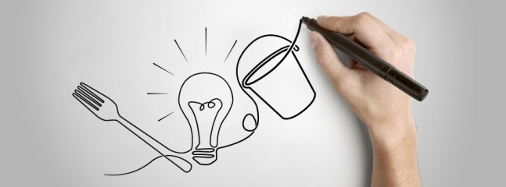

Robotics Packaging Turn-Key Solutions

Slide 2
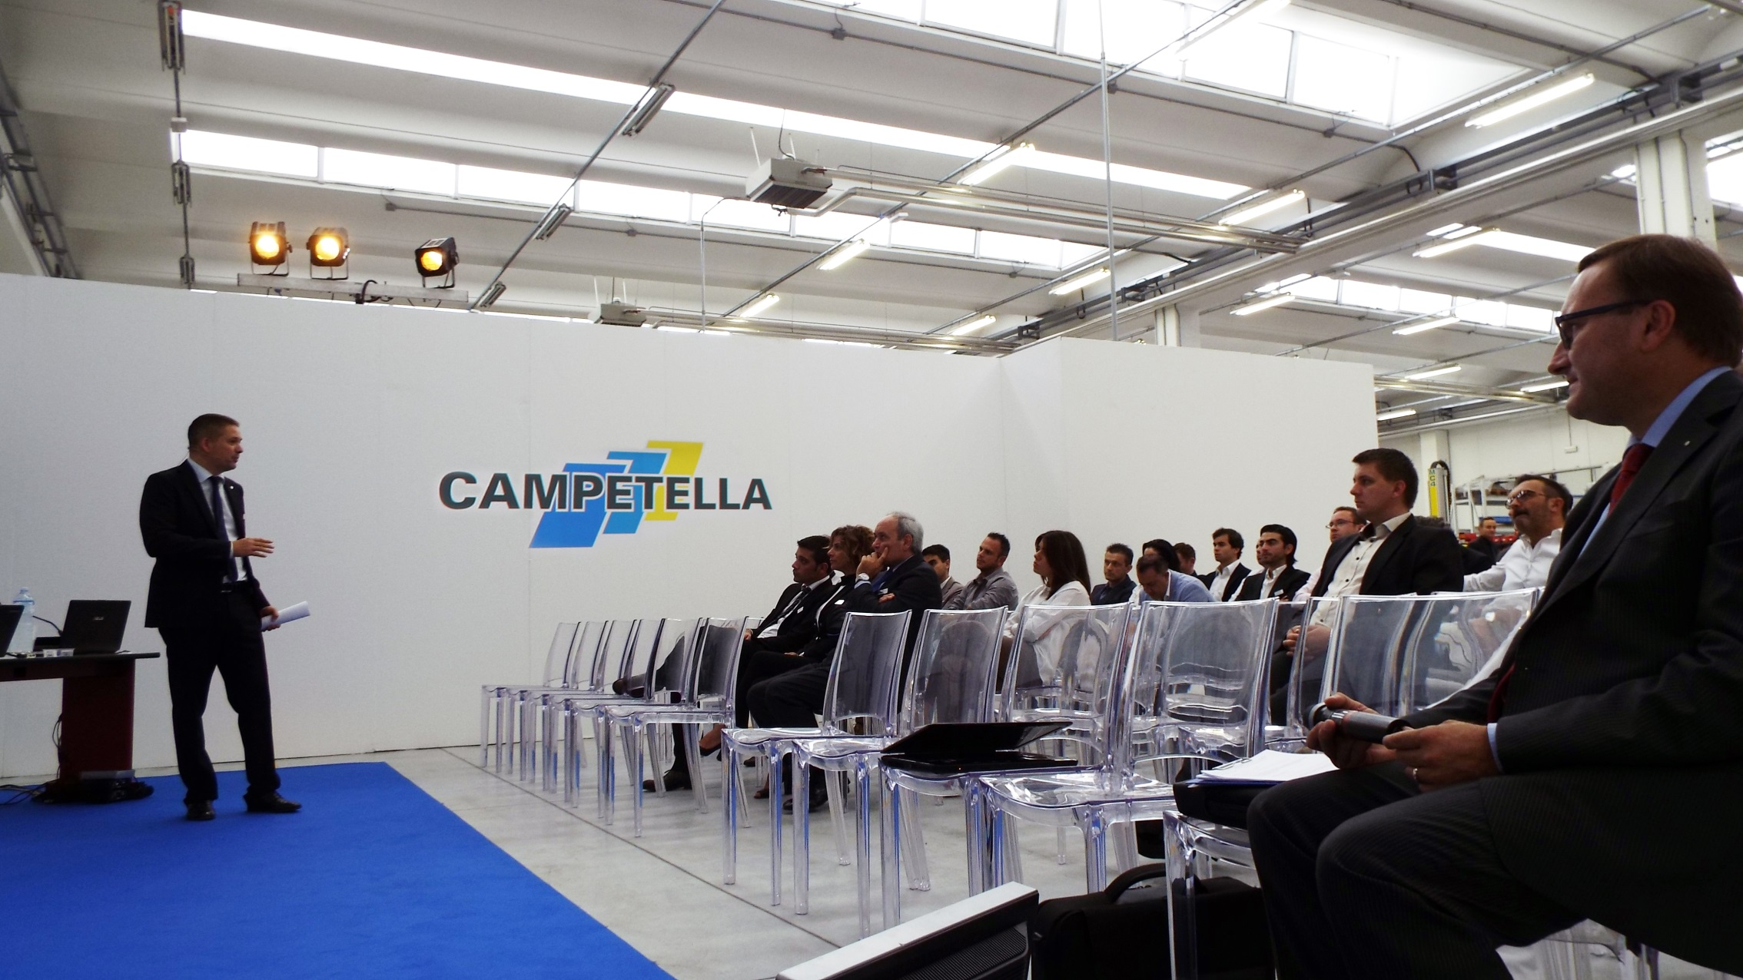

MISSION
To put to the customer’s disposal our passion, know-how and technology and to accompany them through the world of industrial automation and robotics
VISION
to be a worldwide operating, well-structured and organized partner
to establish a strong partnership based on trust and reliability strengthen through a clear and open approach
to be always a step ahead through constant innovation

Slide 3


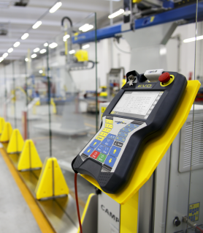
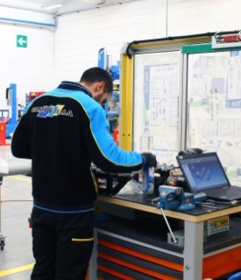
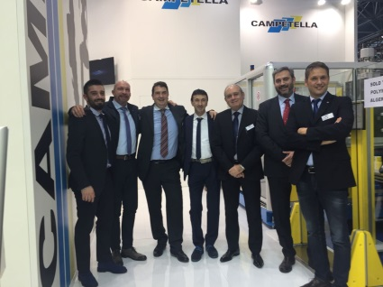
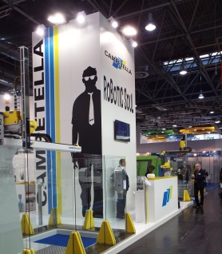
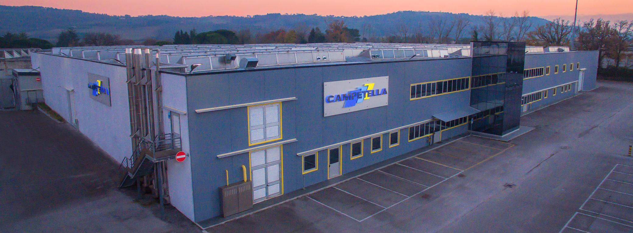
History
«The SMART way of Engineering»
“The artisan company founded in 1897 by Pasquale Campetella in Montecassiano, a small town in the heart of Marche region, has evolved into an important player, which has achieved success in Europe and worldwide thanks to its winning robotic solutions in plastic injection molding”

Slide 4
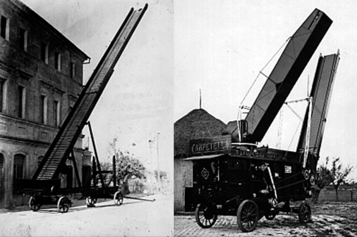
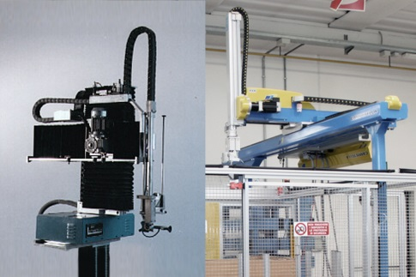
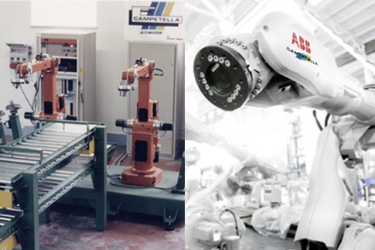
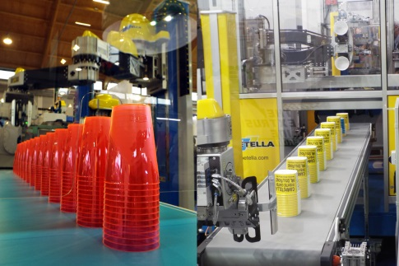

Since 1897 120 years anniversary
1897-1980
Agriculture machineries
Since1980
Industrial automation
Since 1985
integration of 6 axes robots
Since 2000
Packaging, the new challenge

Slide 5
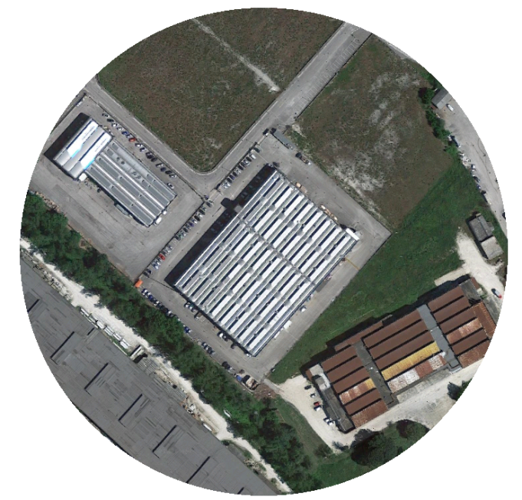
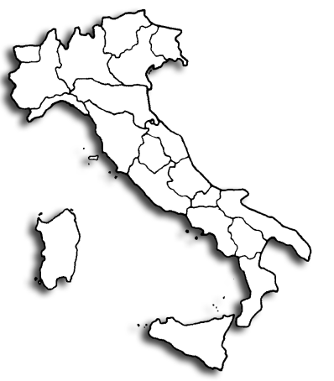

Campetella in Italy
“Marche's economy is mostly based on the traditional manufacturing sectors for typical Made in Italy products such as shoes, clothing, electric appliances, machinery, furniture, automotive.
The industrial vocation of the region is confirmed by the presence of excellent mould makers and moulders of the Italian plastic industry.”

Slide 6
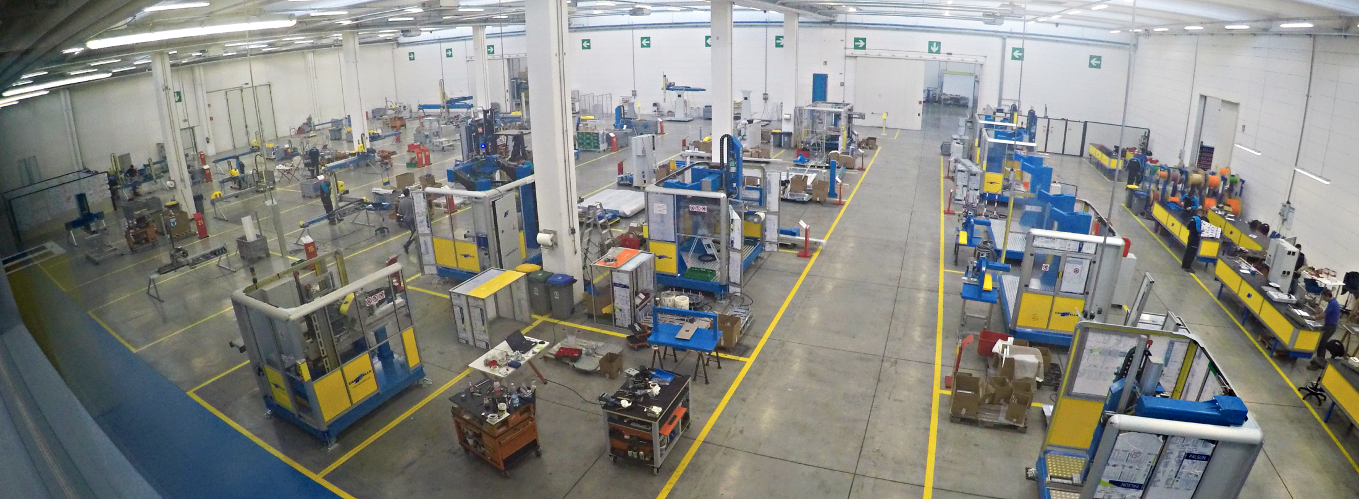
Campetella today
Employees: 94
350 robots installed In 2016
Domestic: 20%
Export: 80%
15,000,000 € Turn Over in 2017
New Plant of 8500 m2
Cooperation with international suppliers
21 Distributors and Service Centers world wide
Business in 26 countries
Industry 4.0
Lean production

Slide 7

Growth Rate 2010 - 2016

Slide 8
Business Units
Business Units
Packaging market

Slide 9
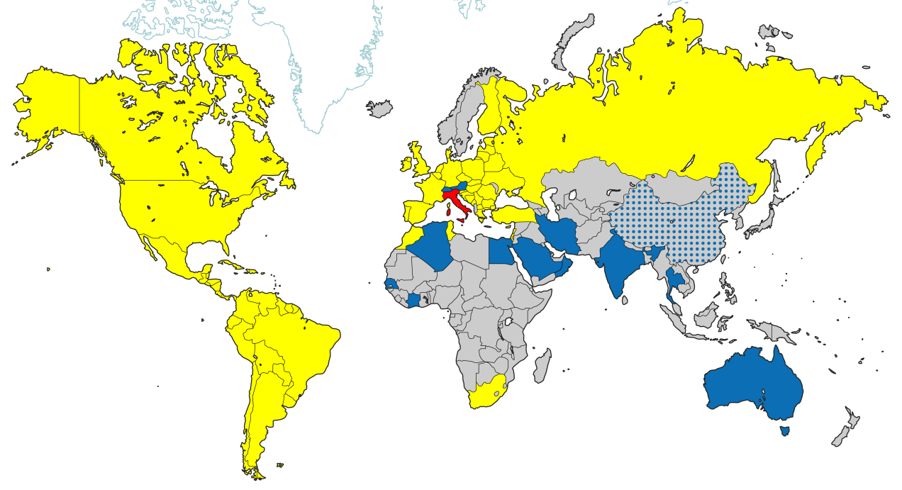

Campetella World Wide
Local Sales & Service
Direct from Italy
Future project

Slide 10
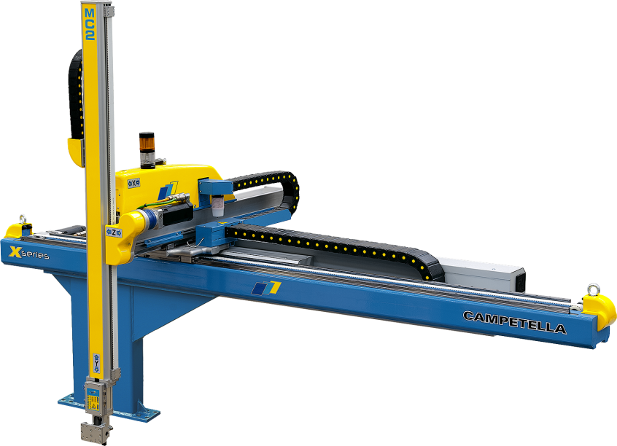
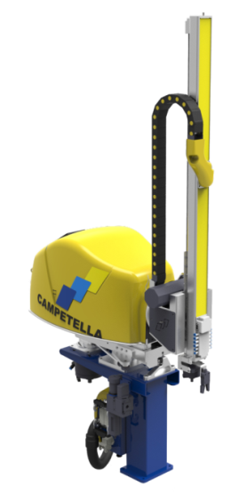
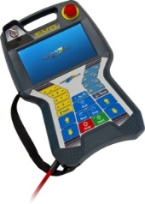
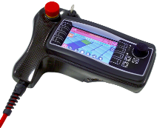
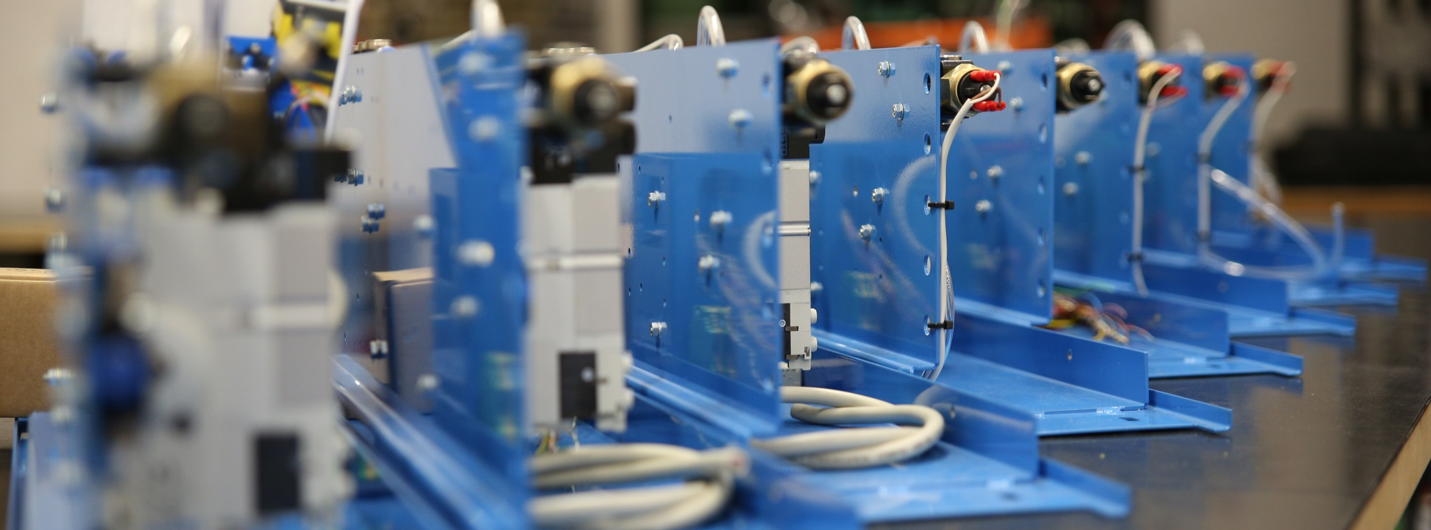
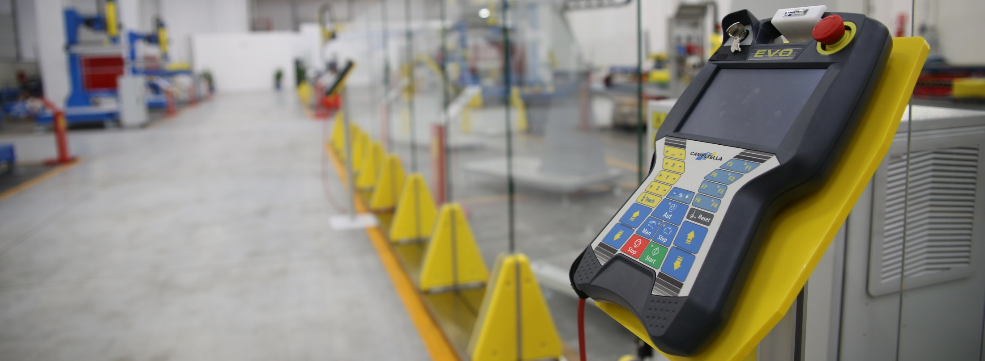
Linear Robots from 20 up to 6000 ton
CAMPETELLA is offering a full range of robots for the flexible automation of injection molding machines
From small, up to presses with very large clamping forces.

Slide 11
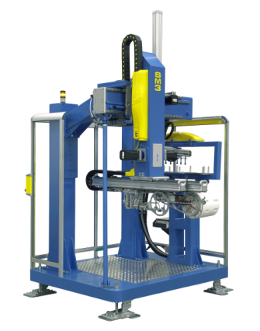
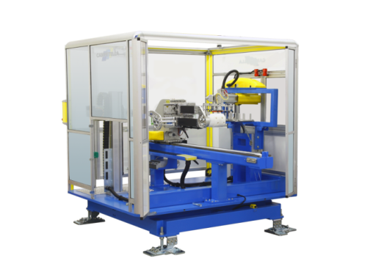
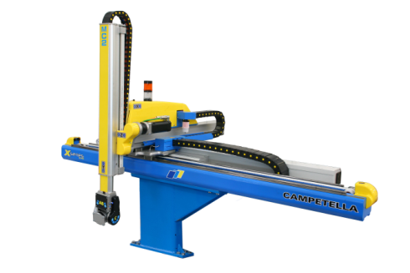
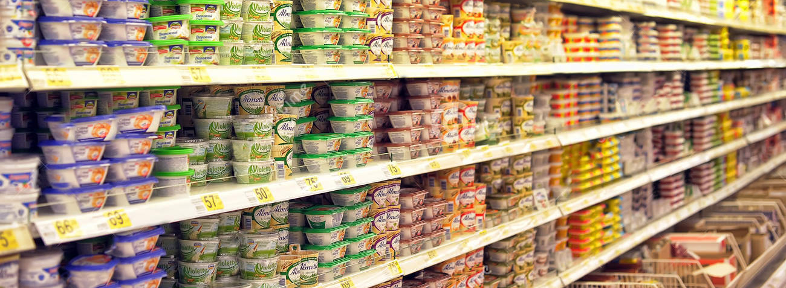
IML «In Mold Labeling»
From standard to dedicated applications, keeping in mind:
Production efficiency
High flexibility
High speed performance
Reliability
Service and Support
MC2
Total cycle time: 7 sec
IMM interlock: 1,5 sec
SM2
Total cycle time: 3 sec
IMM interlock: 0,5 sec
SM3
Total cycle time: 7,5 sec
IMM interlock: 1,7 sec
Modula
Total cycle time: 3,5 sec
IMM interlock: 0,35 sec

Slide 12

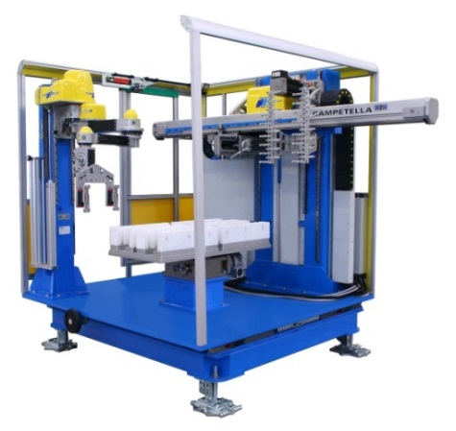
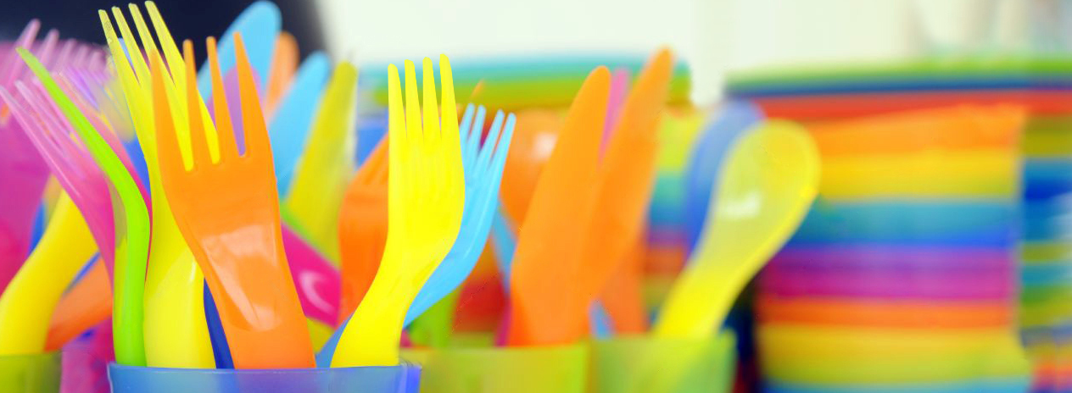
Cutlery
From standard to dedicated applications, keeping in mind:
Production efficiency
High flexibility
High speed performance
Reliability
Service and Support
MC2
Total cycle time:8 sec
IMM interlock:1,5 sec
Max 32 Cavity mold
SM2
Total cycle time: 5 sec
IMM interlock: 0,5 sec
Max 32 Cavity mold
Concept
Total cycle time: 4,5 sec
IMM interlock: 0,35 sec

Slide 13

Customer Service
Training and Technical Assistance
9 senior Campetella technicians
8 authorized service centers in Italy
21 authorized service centers World Wide

Slide 14

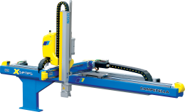

Support
Off LINE SOFTWARE FOR PC
OFFLINE: working cycle creation and modification
ON-LINE: diagnostics of operating state
ON LINE REMOTE ASSISTANCE
«Passion meets Engineering»

Slide 15
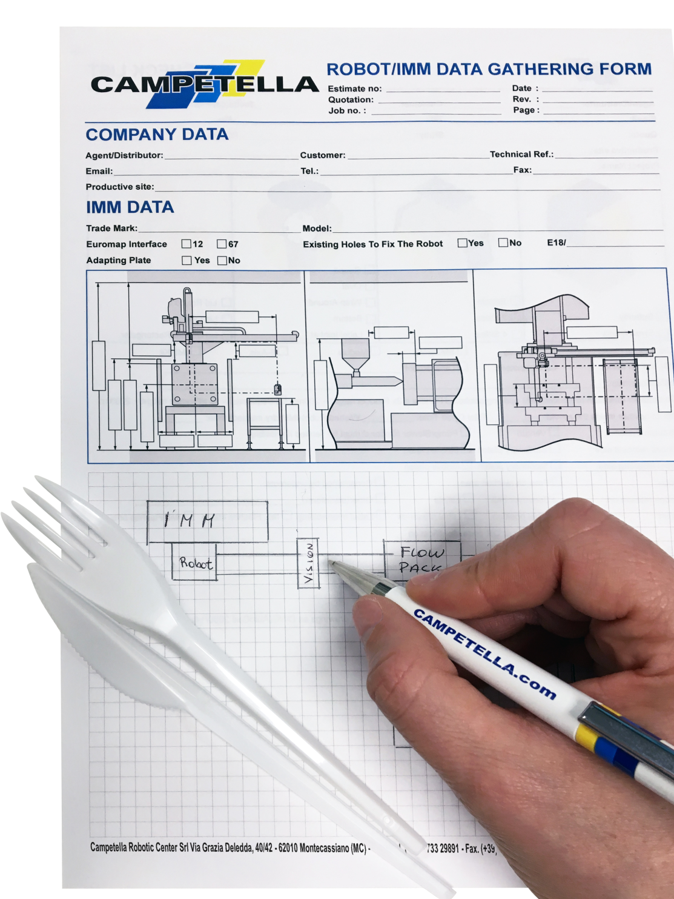


Turn-Key solutions
From the injection molding machine and robot to the automation and peripheral equipment. CAMPETELLA designs your project and delivers turnkey system solutions with perfectly aligned sequences.
You can rely on the highest part quality, stable processes and maximum productivity.
^{Take out time: 0,45s}
^{Total Cycle time: 4,9s}

Slide 16

Turn-Key Benefits
Easier project management
One engeneering team, one leader
Higher flexibility In design changing
Faster time to time market
Time line always under control
Clear cost overview
Clear return on investment
Only one Service team
Ready to go

Slide 17
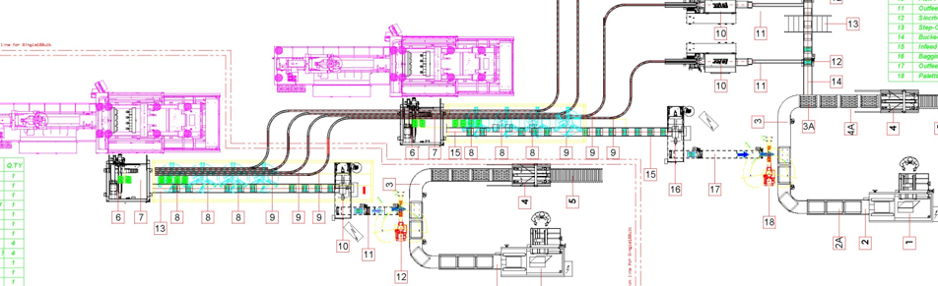
Turn-Key solution

Slide 18





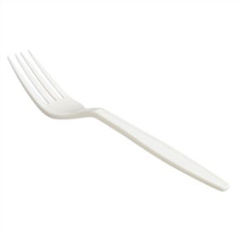
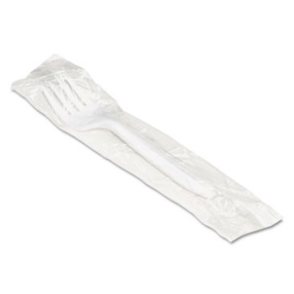
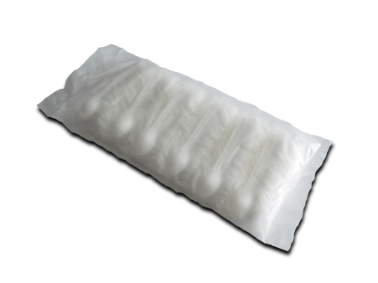
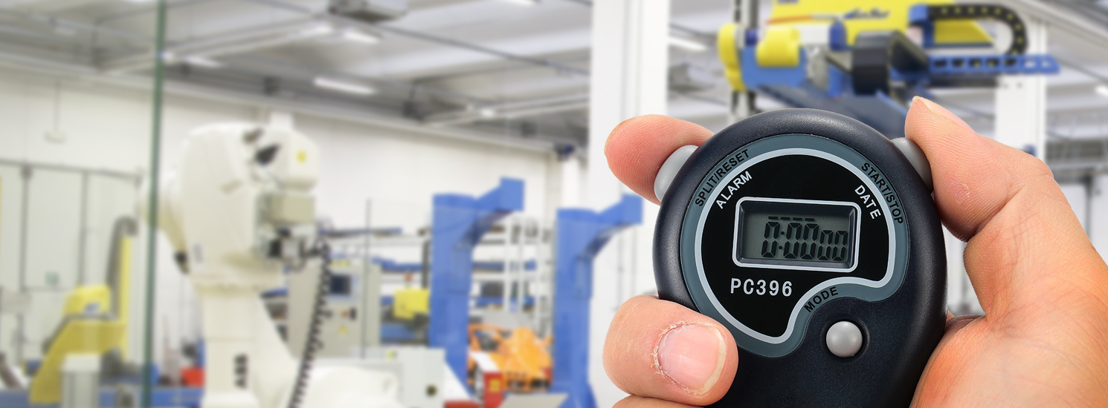
Product specifications
Forks
Material: PS
Weight: 2,3 g
1.110.000 pcs/day
Single pack
Material: HDPE
Pillow pack
Material: BOPP
18.500 pillows/day
Carton box
Dimension
600 x 400 x H300
370 boxes/day

Slide 19
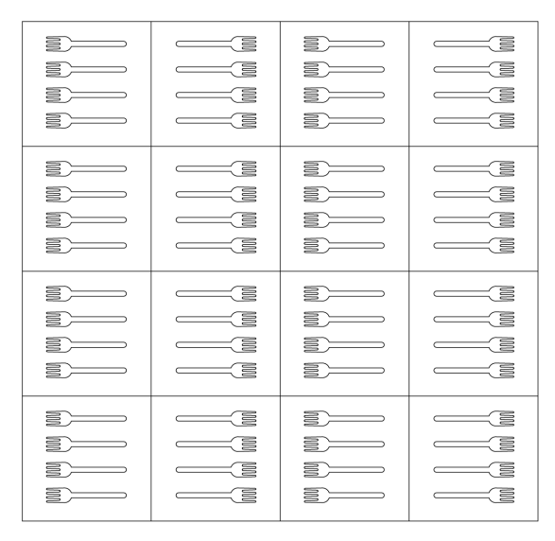
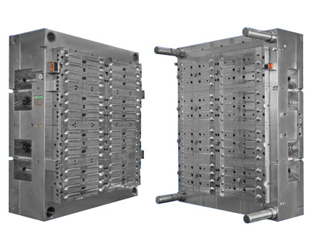
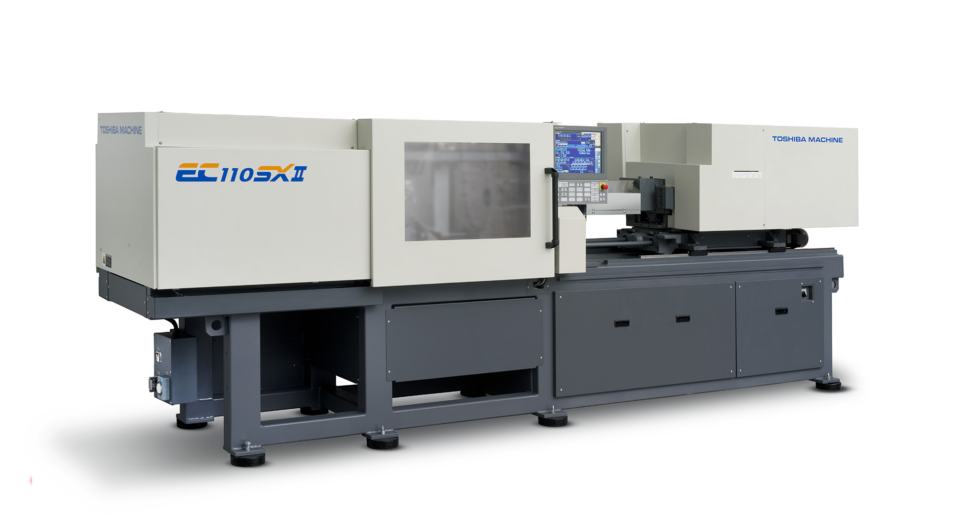
Molding
^{Forks} ^{64 cavities mould}
Mould with 16 inserts x 4 cavities
^{Open gate hotrunner}
^{Cavity distance: 38mm}
^{Total cycle time: 4,5 sec}
Full electric Injection molding machine 400 ton

Slide 20
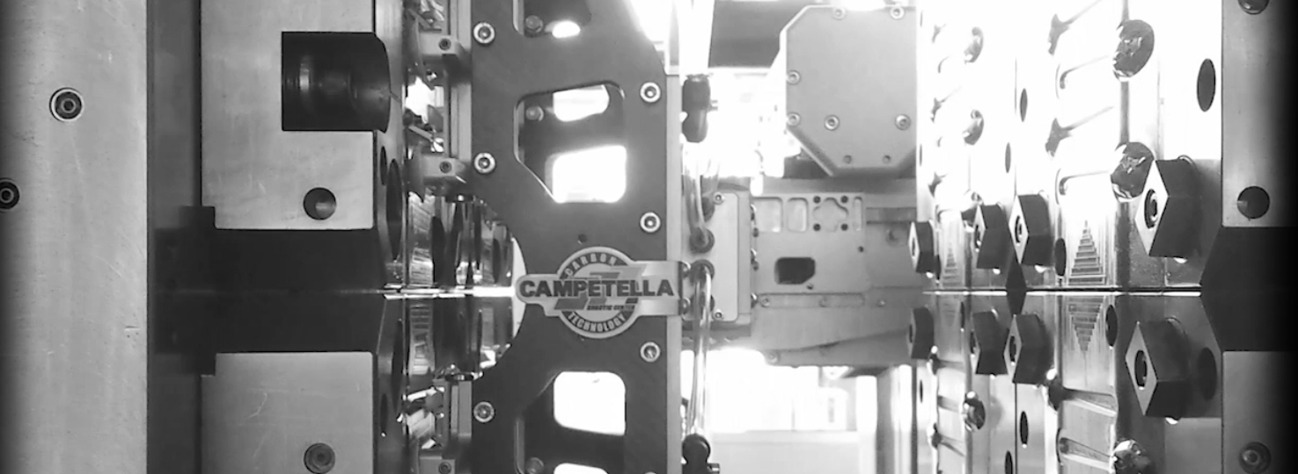
Side Entry Robot
High Speed Side Enty Robot for a extremely short take out time.
CNC controlled, Servo motors
Anti vibration system
Carbon fiber EOATs
Easy to program
HSI Interface
^{Take out time: 0,45s}
^{Total Cycle time: 4,9s}

Slide 21
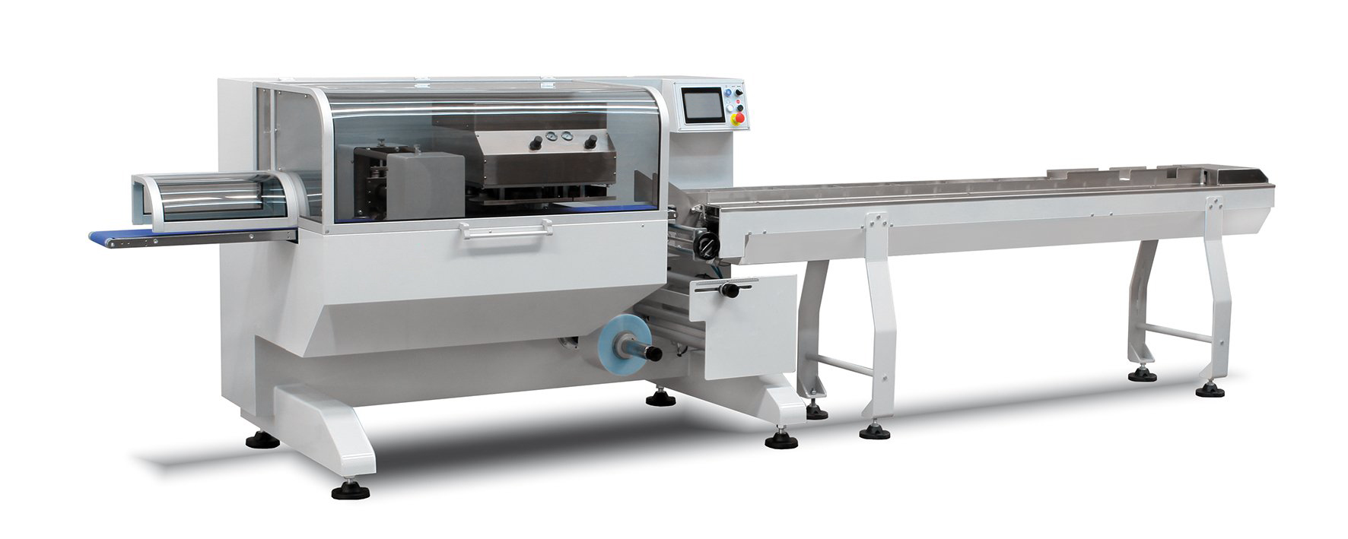
Packaging and wrapping
Full servo linked to the automation lines. The bottom film feed (reverse flowpack) allows the packaging of single and pillow packaging.
Ideal for cutlery
Selected CAMPETELLA partners.
Fully integrated

Slide 22
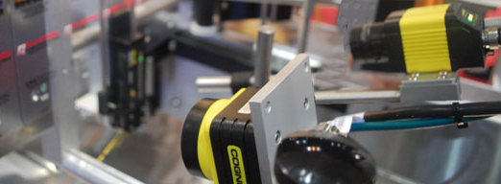
Vision quality control
Industrial optical image processing. That means faulty products in the production process are reliably identified and ejected, and only perfect products are supplied. The result? Increased quality and process speed.
Black dots
FlashesShorts
Statistics

Slide 23
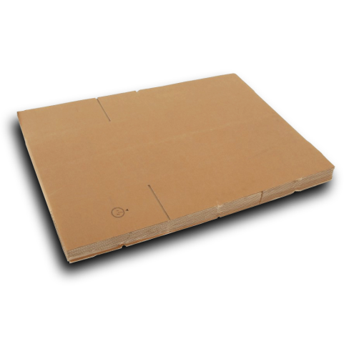

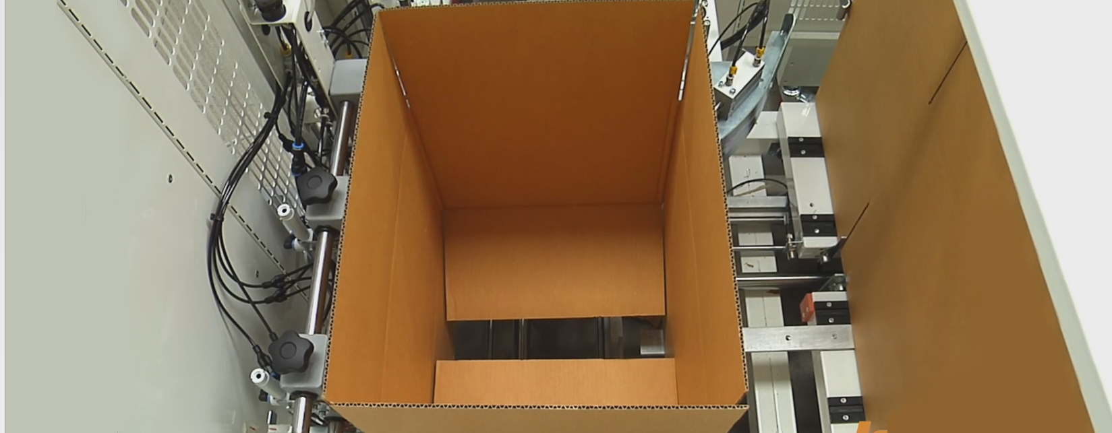
Carton Box filling
Carton box erector and sealer complete of conveying systems
Selected CAMPETELLA partners.
Fully integrated

Slide 24
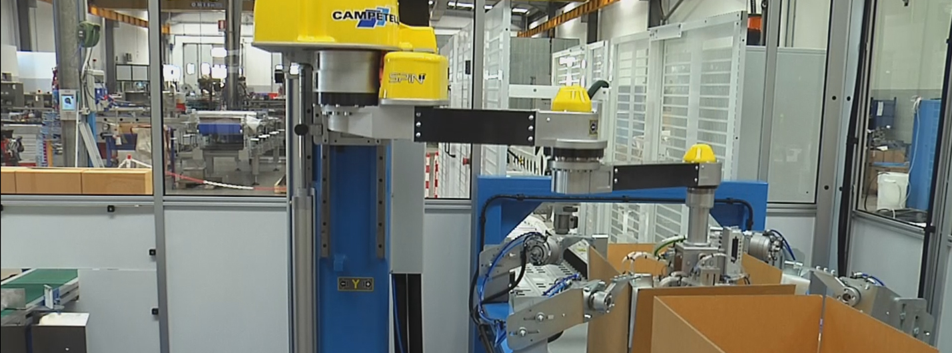
Scara Robot Spin
Campetella standard scara robot
Small footprint
Multipurpose utilities as:
  Stacking,
  palletizing,
  unloading or assembling

Slide 25
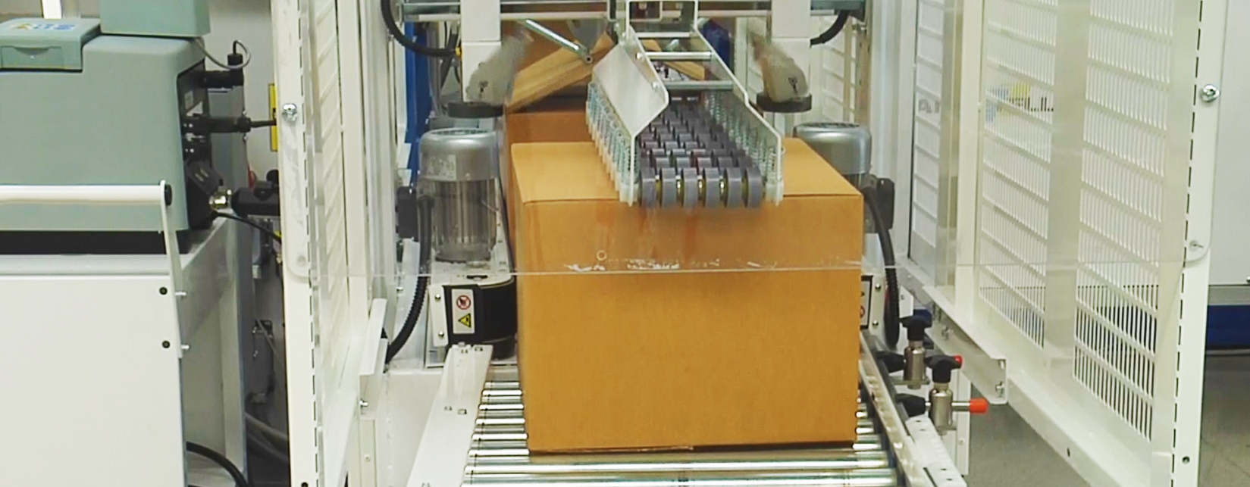
Box closing and labelling
Carton box erector and sealer complete of labeler or printer
Selected CAMPETELLA partners.
Fully integrated

Slide 26

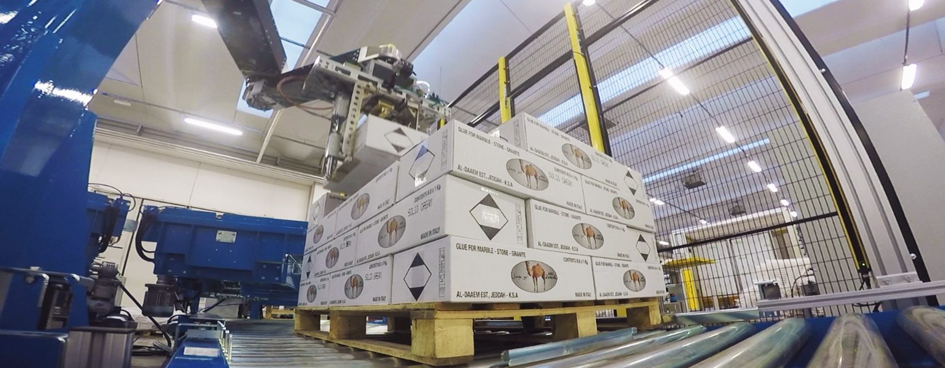
Palletizing
Campetella standard scara robot
Small footprint
Multipurpose utilities as:
  Stacking,
  palletizing,
  unloading or assembling

Slide 27

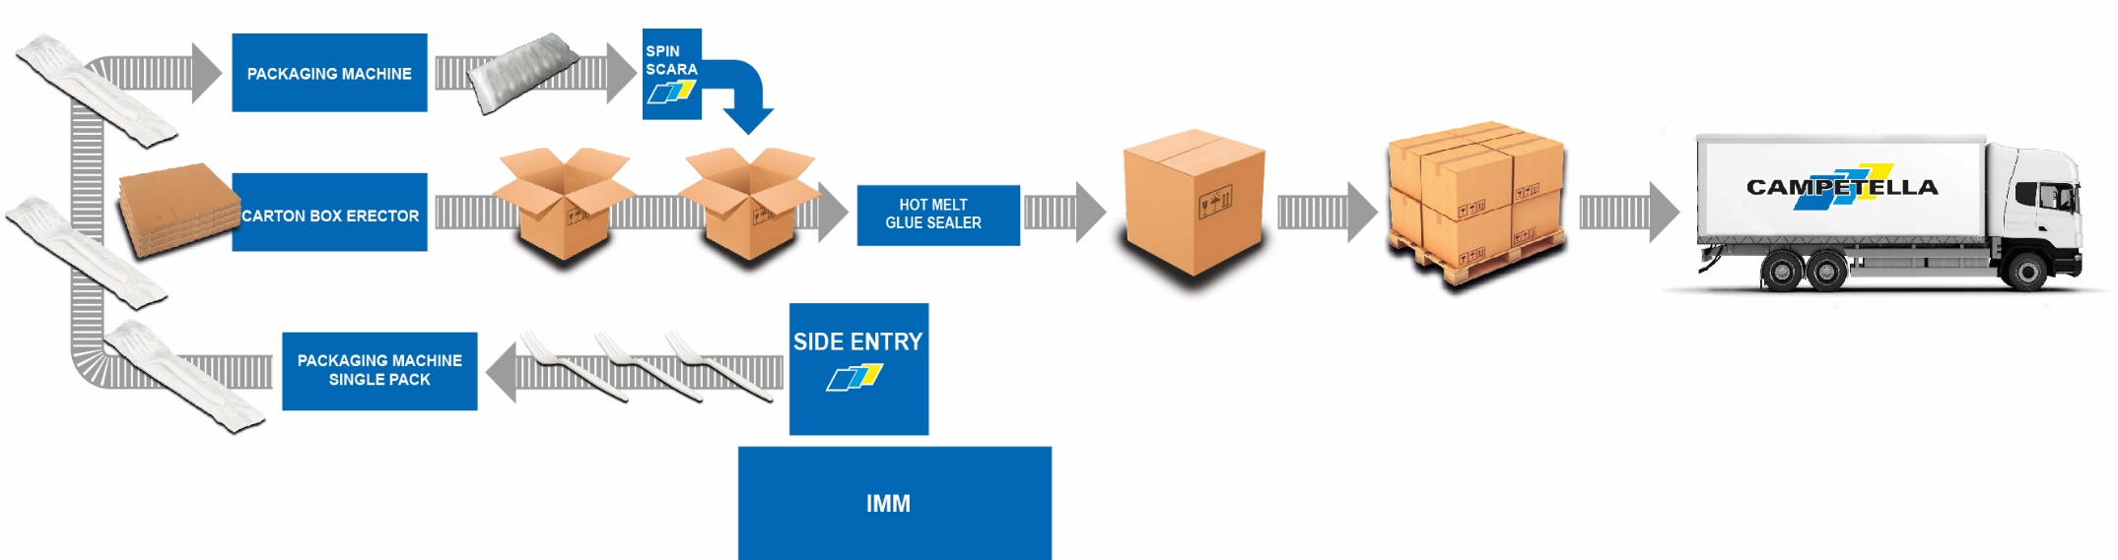
SUMMARY
Forks are being molded on a 400 ton IMM producing 64 forks in 4,5 sec prior to the downstream automation.
A Side Entry Robot removes the forks from the mold.
The dedicated robot EOAT reduces the pitch of the forks with help of cam-motion system and releases the forks on a conveying system.
After vision inspection the forks are packaged individually in a Flow-Pack machine and immediately after that they will be conveyed to the next station to be bagged in one pillow bag with a total of 60 forks.
Meanwhile an automatic carton erector is preparing an empty carton box ready to be filled with the bagged spoons by using a scara robot.
Once full, the box will be automatically closed and glued, ready to be loaded with a palletizing scara on pallets ready to be loaded on a truck.

Slide 28
VIDEO

Slide 29

Robotics Packaging Turn-Key Solutions

